Slide 1
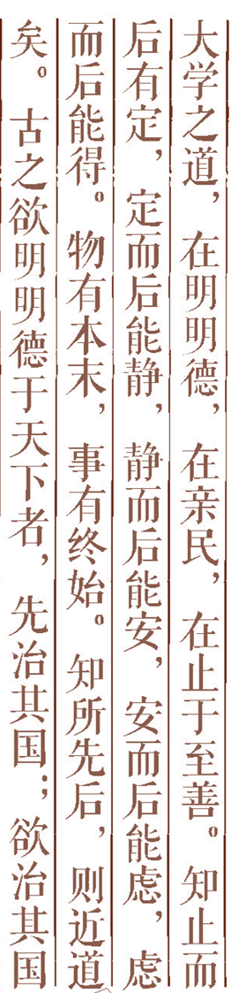


Part III Knowledge Representation and Reasoning

Slide 2



Slide 3



Propositional Calculus
Resolution in Propositional Calculus
Predicate Calculus
Resolution in Predicate Calculus
Knowledge-Based Systems
Representing Commonsense Knowledge(常识知识的表示)
Reasoning with Uncertain Information
Learning and Acting with Bayes Nets
Outline

Slide 4
13 Propositional calculus
Using constraints on feature values
Language
Rules of Inference
Definition of Proof
Semantics
Soundness & Completeness
PSAT problem

Slide 5
You’d better pay attention to the following topics:
Syntax of propositional calculus
Semantics of propositional calculus
The relationships between
Δ |- α and Δ |= α

Slide 6
13.1 Using constraints on feature values
Two ways of modeling the world
features (binary): descriptions for what is and what is not
iconic models: simulations of some aspects of the world
Advantages of iconic representations
direct association with the problem
often more efficient (e.g. in planning)

Slide 7
Advantages of features
Easy to communicate between agents
Computation often lighter (0/1)
Inference from other features
features that can not be sensed directly!
use constraints imposed on the world
Some information is hard to represent iconically
general laws (all x have property p)
negative information (x does not have property p)
uncertain information (x has either property p or property q)

Slide 8
Inference & reasoning
This ‘hard’ knowledge can (sometimes) be formulated as
constraints on feature values
constraints = knowledge about environment
Then new information is obtained by
reasoning from the current state instead of
projecting it from future states (search & plan)
Expert system: typical application of reasoning
set of features models a physical system
constraints encode the physical laws on system
reasoning between ’symptoms’ and ’causes’ = diagnosis

Slide 9
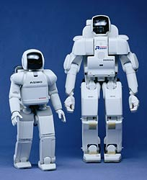
Example
A
B
C
Robot can lift a block if
block is liftable and
battery power source is adequate
Conditions are based on binary features
x1 (bat_ok)
x2 (liftable)
x3 (moves)

Slide 10
Example...
Assume
bat_ok & moves can be sensed, liftable not
how to find out liftable?
we know
if x1 = x2 = 1 then x3 = 1
reasoning:
if x3 = 0 either x1 = 0 or x2 = 0
if x1 = 1 then x2 must be 0 (and vice versa)
we can do it → robot can do it?

Slide 11
What we need?
Language to express
features
constraints on the values of features
Inference mechanism(s) to do the reasoning
Possible choices
propositional calculus
predicate calculus
logic languages in general
We present these languages before proceeding to agents using reasoning capabilities

Slide 12
What makes a ’logic’?
Language (syntax)
defines the (legal) sentences of the language
Semantics
tells what our sentences (and inference) mean
gives the connection between the language and the (modeled) real world
Inference rules
show how to manipulate the of sentences written in our language

Slide 13
13.2 Language of propositional calculus
Note: we discuss the ‘meaning’ of these elements later, here we just give them in a list
Atoms
‘reserved’ atoms T and F
all strings beginning with a capital letter

Slide 14
Connectives
disjunction ∨, conjunction ∧
Implication ⊃, ⇒
antecedent and consequent
equivalence ⇔
negation ¬
Literals: atoms & negated atoms
Well-founded formulas (wff)
use parenthesis to define subformulas

Slide 15
Well-founded formulas
Definition WFF :
Any atom is a wff;
If Q and P are wff, so are
Q∧P(called a conjunction of Q and P)
Q∨P (called a disjunction of Q and P)
Q⊃P (called an implication)
¬Q (called a negation of Q)
There are no other wffs.

Slide 16
For exmaple
Show that (Q∧P)⊃¬R is a wff;
Show that P⊃¬ ¬ is not a wff;

Slide 17
13.3 Rules of Inference
Inference rule
tells how to create new wffs
given a set of them
General form
“γ can be inferred from α1,…,αn”
Commonly used rules
Modus Ponens
∧-introduction and ∧-elimination
commutativity laws
∨ -introduction
double negation

Slide 18
13.4 Definition of Proof
Sequence of wffs w1,…,wn is a
proof (deduction) of wn
from a set of wffs Δ iff each wi is either
a member of Δ or
inferred from earlier wffs
i.e. wi has already a proof
“wn is a theorem of Δ”
Notation: Δ |- wn
Note: possible proofs depend on the set of inference rules used in the proof

Slide 19
Proof trees
Proofs create a partial order
inferred wffs depend on other wffs etc...
proof trees express this ordering
Proof tree (see Fig. 13.1)
nodes are labeled with wffs (of the proof)

Slide 20
each node is either:
a member of Δ or
inferred from it’s descendant nodes
tree is a proof of it’s root node
note: proof trees are often drawn ’upside-down’

Slide 21
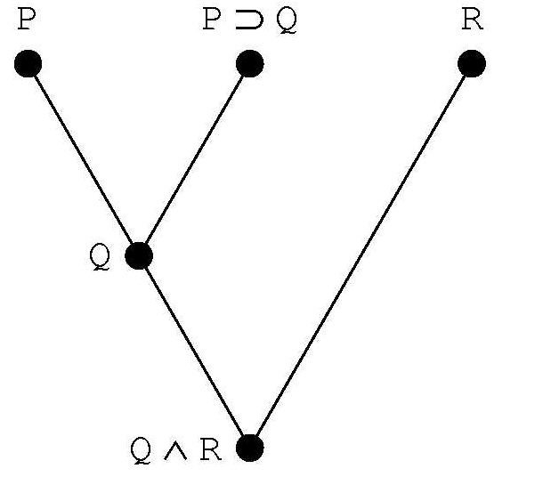
A Sample Proof Tree

Slide 22
13.5 Semantics
Interpretations(解释)
Truth tables（真值表）
Satisfiability, models
Validity（有效性）
Equivalence
Entailment（蕴涵）

Slide 23
13.5.1 Interpretations
An interpretation associates
the elements of language with
the domain of discourse
Meaning of an atom?
proposition (statement) about the world

Slide 24
e.g. bat_ok → “the battery of the robot is ok”
Interpretation
set of all associations of atoms and propositions
denotation of an atom: associated proposition in a given interpretation

Slide 25
Interpretations...
Given an interpretation, we can say whether atoms are true or false
value of atom α?
suppose α is associated with proposition P
if P holds then α is true
if P does not hold then α is false

Slide 26
Special atoms
T: always true
F: always false
Define interpretations as truth assignments（指派） to atoms
we don’t even have to know their true meanings
propositions are either true or false (whatever they are) → atoms are either true or false

Slide 27
13.5.2 Truth tables
Truth table
gives a way to compute the value of any wff F in a given interpretation
contains all subformulas of F (F included)

Slide 28
合 取 词(Conjunction) ∧
P | Q | P ∧ Q
0 | 0 | 0
0 | 1 | 0
1 | 0 | 0
1 | 1 | 1

Slide 29
条 件 词 ly)(蕴 涵 词) ⊃（ ⇒ ）
P | Q | P ⊃ Q
0 | 0 | 1
0 | 1 | 1
1 | 0 | 0
1 | 1 | 1

Slide 30
例：如果 P:我拿到奖学金，Q:我就请客.
各种情况的真值：
情况1：没拿到，也没有请客；没失言
情况2：拿到，没请客； 失言
情况3：没拿到，也请客；没失言
情况4：拿到，也请客 没失言

Slide 31
Exercise:
shows the semantics of connectives
note: (P ⇒ Q) ⇔ (¬P ∨ Q)
Example
P false, Q false, R true
value of ((P ⇒ Q) ⇒ R) ⇒ P ?
build syntax tree, evaluate bottom-up

Slide 32
Truth tables...
Fact:
n atoms have 2^n possible interpretations
→ methods using truth tables have exponential time complexity
A reverse problem
given a set of wffs Δ and their values, is there a unique interpretation where these values hold?

Slide 33
important
Δ = constraints the agent has
interpretation = state of the world
constraints → (unique) state?
but often there is no unique interpretation
More realistic ‘reverse problem’
are there any interpretations where the formulas of Δ have the given values?

Slide 34
13.5.3 Satisfiability, models
Interpretation I satisfies a wff α
iff α is true in I
in other words: I is a model of α
generalization: set of wffs
‘Model property’ can be checked with truth tables
example: bat_ok ∧ liftable ⇒ moves

Slide 35
each non-trivial wff rules out some possible models
constraints on the world
more wffs → less models
‘the more we know about the world the less we must guess’
No interpretation satisfies set Δ?
Δ is said to be inconsistent or unsatisfiable
examples: F, P ∧ ¬P

Slide 36
13.5.4 Validity
wff α is valid iff
α is true in all interpretations
“tells nothing” about the world
general laws about wffs
examples (check with truth table)
P → P
Q ∨ T
((P → Q) → P) → P

Slide 37
13.5.5 Equivalence
wffs α and β are equivalent iff
α and β have the same value in all interpretations
or alternatively: α and β have the same models
book notation: α ≡ β
Examples
De Morgan laws
contraposition
reduction to implication

Slide 38
13.5.6 Entailment
Set of wffs Δ, wff α
Δ logically entails α
if M is a model of Δ then
M is a model of α, too
models of Δ are a subset of the models of α
Other words
α is a logical consequence of Δ
α follows logically from Δ
Notation: Δ |= α

Slide 39
Entailment...
Entailment is an important concept
strong way of showing “given the state of affairs, X must hold”
Example case
bat_ok ∧ liftable → moves
sensed facts: bat_ok, ¬moves
liftable is false in all models of the 3 wffs above
→ ¬liftable MUST be true

Slide 40
Entailment...
Given that
α is a logical consequence of Δ
We know that
α is true in all interpretations where Δ is
especially in the intended one! (the one we have in mind)
How to produce entailed wffs?
truth table approach is ineffective
via inference?

Slide 41
13.6 Soundness & completeness
Connection between inference and entailment
Given set of inference rules R
R is sound: Δ |- α implies Δ |= α
R is complete: Δ |= α implies Δ |- α
i.e. a proof exists
the problem is how to find it
IF R is both sound & complete, THEN entailment can be solved via proof

Slide 42
Soundness...
Why important
‘proof methods’ are usually much more effective than ‘truth table methods’
Note: entailment problem is shown to be NP-complete (Cook -71)
but there are many special tractable cases

Slide 43
13.7 PSAT problem
Problem: find one model of Δ
wffs in Δ are satisfiable in same interpretation
→ find a model of conjunction of members of Δ
PSAT = propositional satisfiability problem
reduces to sat. prob. of CNF formulas
systematic search: 2^n states

Slide 44
PSAT...
Subcases of PSAT
k-SAT: longest conjunct in CNF formula has exactly k literals
Known
2-sat: polynomial
3-sat: NP-complete
thus the general problem must be, too
polynomial expected time algorithms
supposing some distribution on truth values

Slide 45
GSAT algorithm
Repair algorithm for PSAT
guess some interpretation= valuation of variables
count number of true clauses
for each atom A, count how many clauses would be true if the value of A were changed
select the one with max, change & continue
terminate after a fixed number of iterations

Slide 46
13.8 Other topics
Language & Metalanguage
Metatheorems
theorems about prop. calculus
deduction
reduction ad absurdum
Associative & distributive laws

